Slide 1

DIAGNOSIS AND TREATMENT SUGGESTION FOR PARKINSON DISEASES USING ML MODEL
Internal Guide
Presented by
Ramya R
Assistant Professor
Yogesh S
4th Year
DEPARTMENT OF COMPUTER SCIENCE AND ENGINNEERING
DHANALAKSHMI SRINIVASAN COLLEGE OF ENGINEERING
COIMBATORE

Slide 2

TABLE OF CONTENTS
PROBLEM STATEMENT & OBJECTIVE
PROPOSED WORK
METHODOLOGY
STATUS OF PHASE I
CURRENT STATUS
SCOPE OF THE WORK REMAINING
REFERENCES

Slide 3
PROBLEM STATEMENT
Parkinson's disease is a progressive neurodegenerative disorder that affects millions of people worldwide. Early diagnosis and accurate prediction are crucial for timely intervention and effective treatment.
However, traditional diagnostic methods often require multiple clinical visits and can be challenging, especially in the early stages of the disease.
Additionally, there is a need for a more precise and tailored approach to treatment, considering the diverse manifestations of the disease and individual patient characteristics.

Slide 4

OBJECTIVES
Develop a machine learning model to diagnose Parkinson's disease at an early stage using patient data, including voice recordings, motor skills assessments, and demographic information.
The model aims to improve diagnostic accuracy, reduce the need for frequent clinical visits, and provide personalized treatment suggestions based on the patient's specific condition.
ABOUT US
Elaborate on what you want to discuss.

Slide 5
PROPOSED SYSTEM

Slide 6


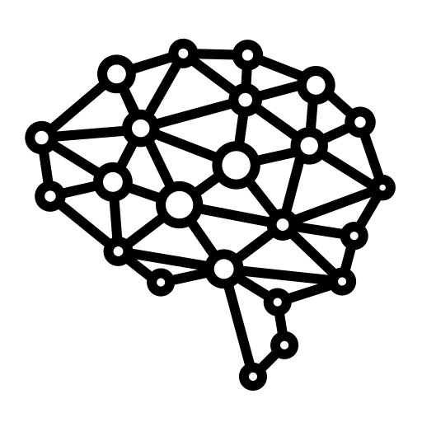



Conceptual diagram of Diagnosis and Treatment Suggestion for Parkinson Diseases Using ML Model
Data Collection
Data Pre-processing
Model Training
Patient Monitoring
Treatment Suggestion
Diagnosis

Slide 7
Status of Phase - I

Slide 8


Data Collection
ABOUT US
Dataset Used – Parkinson Disease Dataset
Dataset Source - UCI Machine Learning Repository
Dataset Hosting URL - https://archive.ics.uci.edu/ml/machine-learning-databases/parkinsons/parkinsons.data
WHO WE ARE?
Briefly elaborate on what you want to discuss.
Elaborate on what you want to discuss.
WHAT WE DO?
Briefly elaborate on what you want to discuss.

Slide 9
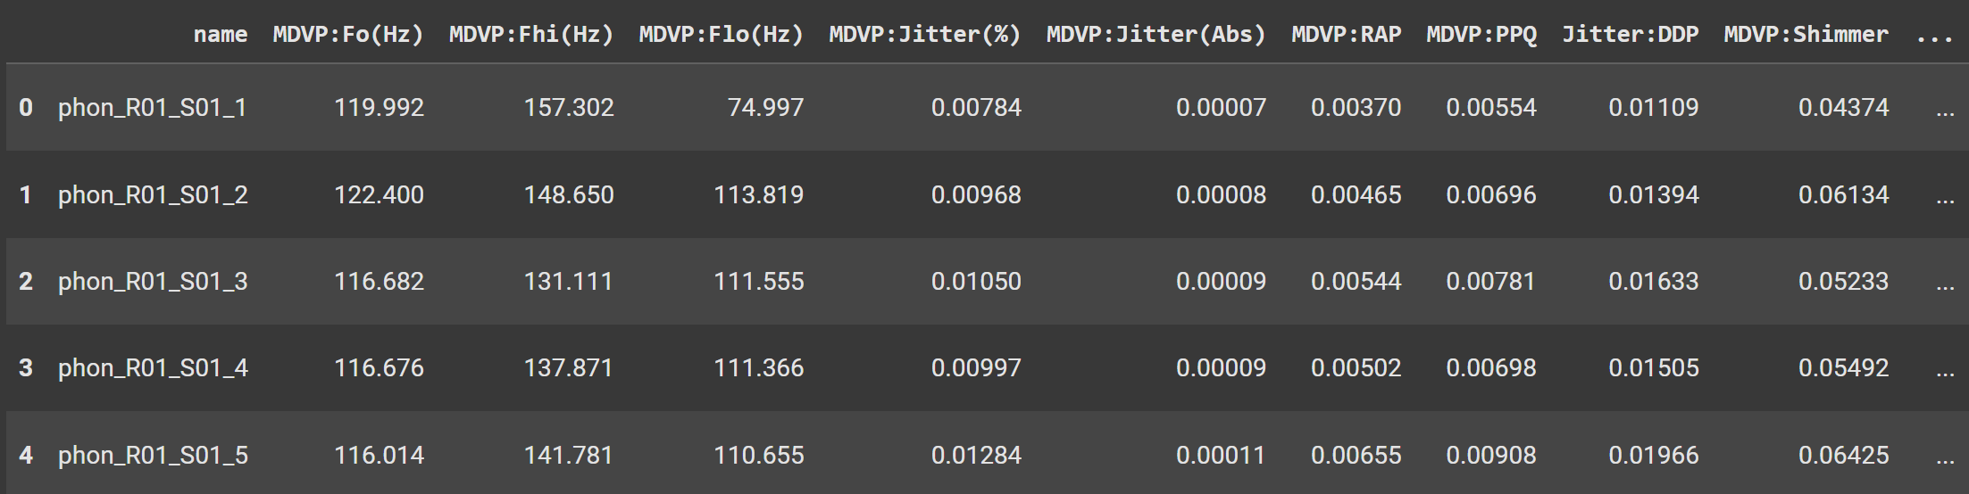
Data Pre-Processing
The following steps are performed on the dataset in this section:
Dropping Redudant Columns
Checking For Duplicated Rows
Checking For Missing Values

Slide 10
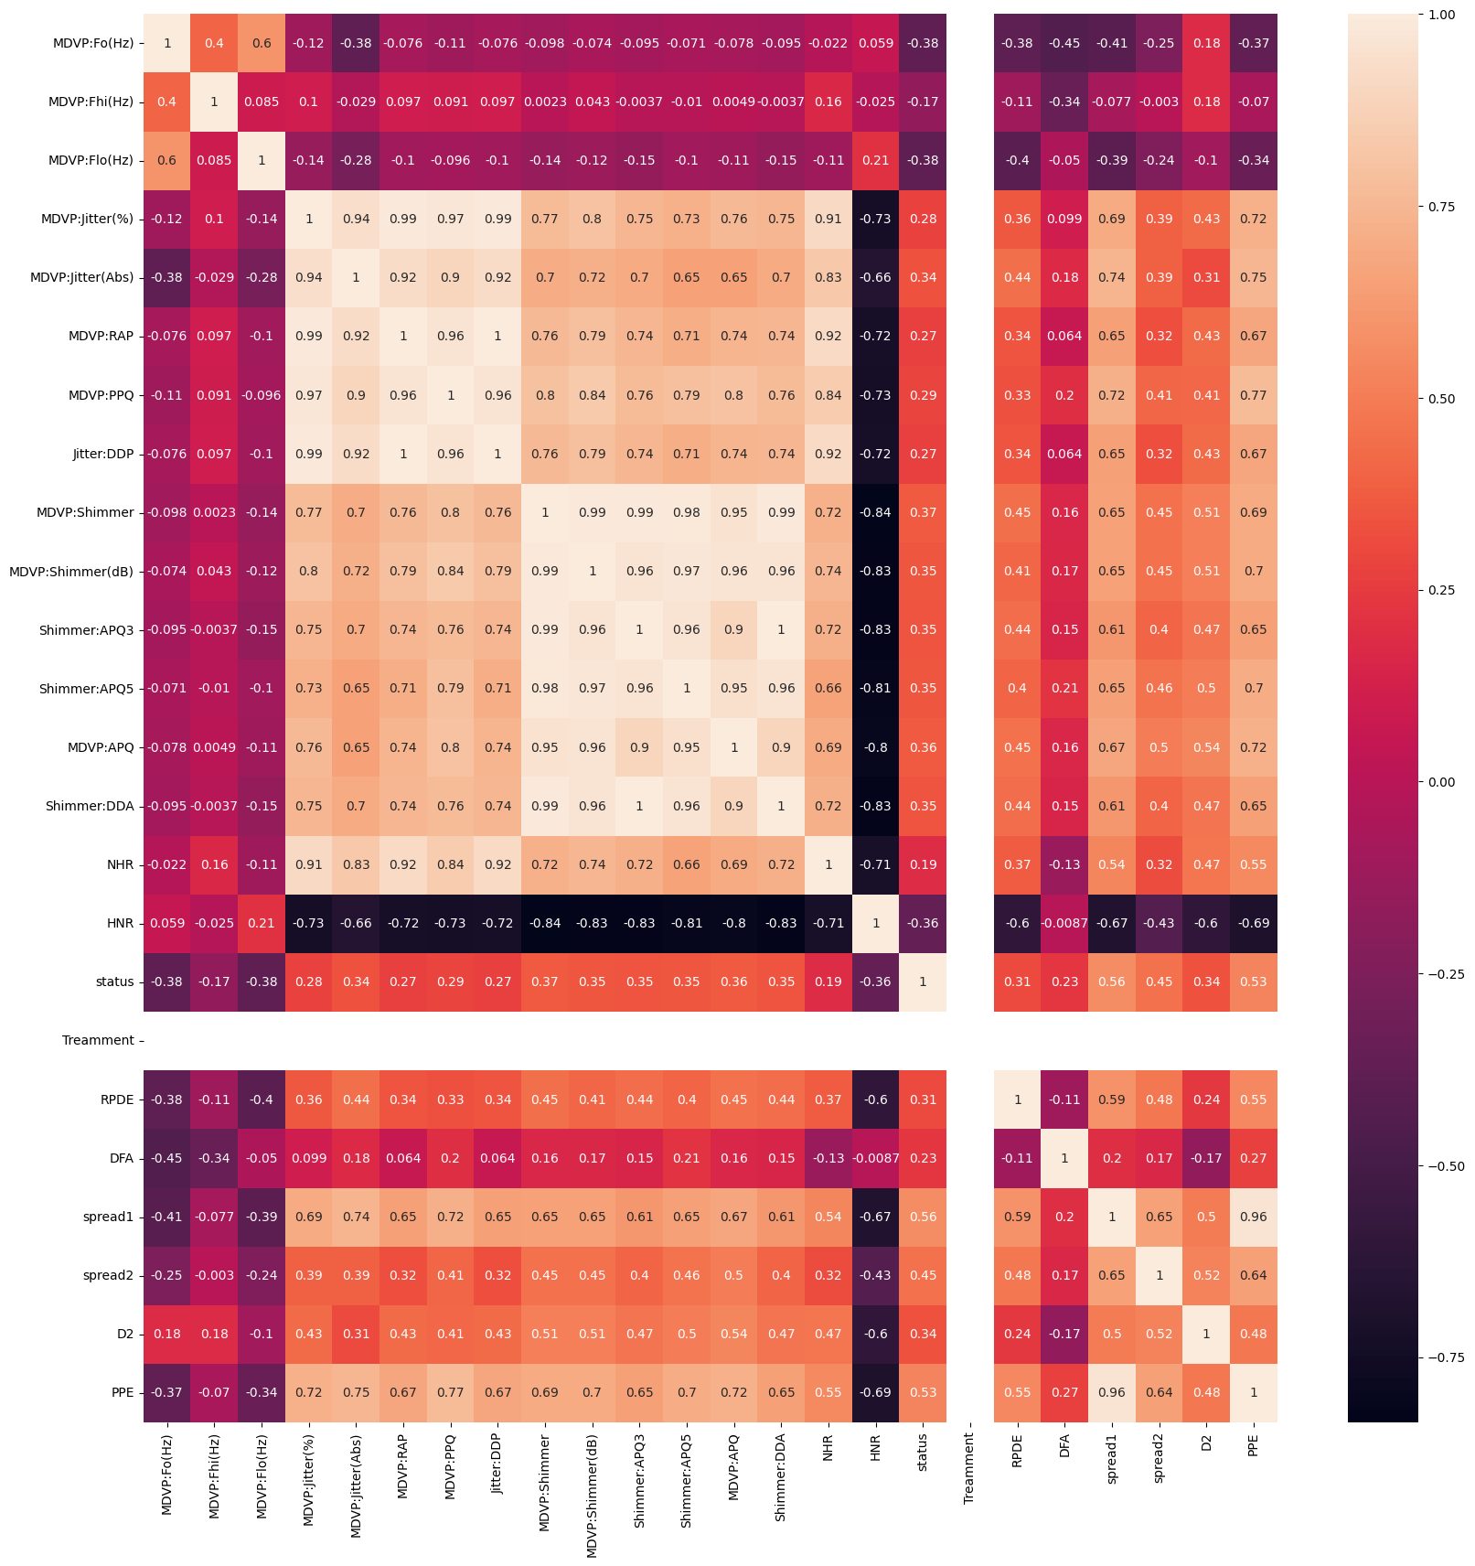
Exploratry Data Analysis
Feature Engineering - Researchers have explored various feature engineering techniques to extract meaningful information from the data Collected from the Hospitals.
Visualization - It can provide insights into the underlying patterns and relationships. Techniques such as scatter plots, histograms, and heat maps have been used to explore the characteristics of PD data.

Slide 11
Model Training and Evaluation
Model Selection - Various ML algorithms have been applied to detect PD, including Decision Trees, Random Forests, Support Vector Machines, and Deep Learning models.
Model Evaluation: Metrics such as accuracy, precision, recall, F1-score, and ROC curves are used to evaluate the performance of the trained models.

Slide 12
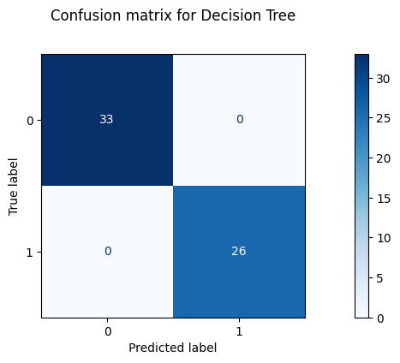
Decision Tree Classifiers
Decision Tree create a tree-like ecision Tree Classifiers are a popular ML algorithm often used in Parkinson's Disease (PD) diagnosis. They model where each internal node represents a test on an attribute, and each leaf node represents a class label (in this case, PD or non-PD).
Divide the data into training and testing sets to evaluate the model's performance and Calculate metrics like accuracy, precision, recall, F1-score, and AUC-ROC to assess the model's ability to correctly classify Parkinson's Disease cases.

Slide 13
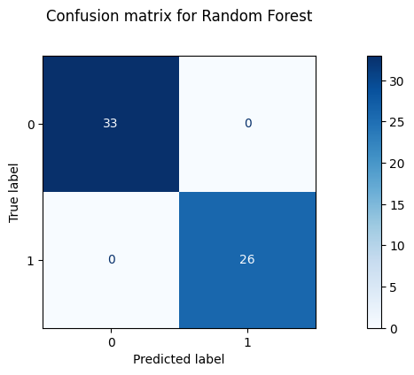
Random Forest Classifier
Random Forest Classifier is a powerful machine learning algorithm that has been successfully applied to various medical domains, including Parkinson's Disease (PD) diagnosis and treatment planning. Its ability to handle large datasets, handle both numerical and categorical features, and provide feature importance measures makes it well-suited for this application.
Random Forest provides a feature importance score for each feature, indicating its contribution to the model's accuracy. The trained Random Forest model is used to predict the likelihood of PD in new patients based on their input features. Based on the diagnosis and the patient's specific characteristics, the model can suggest appropriate treatment options, such as medication, therapy, or surgical interventions.

Slide 14
CURRENT PROGRESS
Random Forest Classifier was found to be the best performing Classifier with:
Accuracy - 0.996102
F1 Score - 0.961538
R2 Score - 0.862471

Slide 15
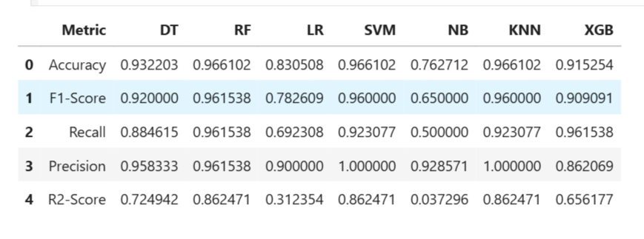
Result of Implementation

Slide 16
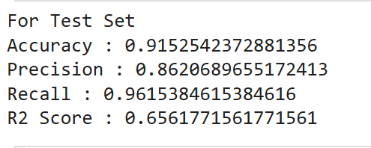
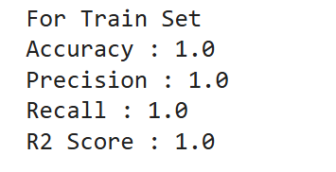
Train and Test Set Result

Slide 17
SCOPE OF THE WORK REMAINING
Completion of Designing Random Forest Model
Completion of Testing and Training the Model
Integration of Treatment Suggestion Data with the model
Application Development
Performance Analysis

Slide 18
Current Work Status
Finalized the Proposed System Architecture
Trained the Model with the Gathered Data Set
Analyse the best Model for Prediction
Splitted the Train and Test Data for Training the model

Slide 19
observations
Average Training accuracy of 87.86
Average Training accuracy of 89.48%

Slide 20
Grover, S.; Bhartia, S.; Yadav, A.; Seeja, K.R. Predicting the severity of Parkinson's disease using deep learning. Procedia Comput. Sci. 2018, 132, 1788–1794. [CrossRef]
Sriram, T.V.; Rao, M.V.; Narayana, G.S.; Kaladhar, D.; Vital, T.P.R. Intelligent Parkinson disease prediction using machine learning algorithms. Int. J. Eng. Innov. Technol. (IJEIT) 2013, 3, 1568–1572.
Esmaeilzadeh, S.; Yang, Y.; Adeli, E. End-to-end Parkinson disease diagnosis using brain mr-images by 3d-CNN. arXiv 2018, arXiv:1806.05233.
Warjurkar, S.; Ridhorkar, S. A Study on Brain Tumor and Parkinson’s Disease Diagnosis and Detection using Deep Learning. In Proceedings of the 3rd International Conference on Integrated Intelligent Computing Communication & Security (ICIIC 2021), Online, 27–28 August 2021; Atlantis Press: Amsterdam, The Netherlands, 2021; pp. 356–364.
References

Slide 21
SherlyPusphaAnnabel, L.; Sreenidhi, S.; Vishali, N. A Novel Diagnosis System for Parkinson’s Disease Using K-means Clustering and Decision Tree. In Communication and Intelligent Systems; Springer: Berlin/Heidelberg, Germany, 2021; pp. 607–615.
Shetty, S.; Rao, Y. SVM-based machine learning approach to identify Parkinson's disease using gait analysis. In Proceedings of the 2016 International Conference on Inventive Computation Technologies (ICICT), Coimbatore, India, 26–27 August 2016; IEEE: Manhattan, NY, USA, 2016; Volume 2, pp. 1–5.
Asmae,O.;Abdelhadi,R.; Bouchaib, C.; Sara, S.; Tajeddine, K. Parkinson’s disease identification using KNN and ANN Algorithms based on Voice Disorder. In Proceedings of the 2020 1st International Conference on Innovative Research in Applied Science, Engineering and Technology (IRASET), Meknes, Morocco, 19–20 March 2020; IEEE: Manhattan, NY, USA, 2020; pp. 1–6.
Nurrohman, A.; Abdullah, S.; Murfi, H. Parkinson's disease subtype classification: Application of decision tree, logistic regression and logit leaf model. In AIP Conference Proceedings; AIP Publishing LLC: Melville, NY, USA, 2020; Volume 2242, p. 030015.
References

Slide 22
THANK YOU!

